Slide 1
WEBSITE FOR INTERNET SERVICE PROVIDER
VINAY DHANANJAY MOHITE
TY.BSC.IT

Slide 2
INTRODUCTION OF PROJECT
The purpose of this Website is to express what the IT community as represented by the T10 expects of Internet Service Providers (ISPs) with respect to security. This document is addressed to ISPs.
In this document we define ISPs to include organizations in the business of providing Internet Connectivity or other Internet services including but not restricted to web hosting services, content providers and e-mail services.
We do not include in our definition of an ISP organizations providing those services for their own purposes.

Slide 3
ADVANTAGES OF PROJECT
GUI: The proposed system will provide better Graphical User Interface.
Increase work speed: Due to automation of some part of the system work speed will increase.
Less paperwork: For the proposed system less paperwork is required.
Reduced errors: Due to computerized there are less possibilities of errors.

Slide 4
LIMITATION OF PRESENT SYSTEM
Maintaining details: Maintaining all the details like member, management, and maintenance is very tedious hob.
Excess paper work: For maintaining records lots of paper gets wasted.
Searching is very difficult: Searching for details about member, his maintenance, worker etc. is tedious.
Time consuming: Due to manual work, it takes lot of time to record a data as well as for searching.
Misplacement of records: Since records are stores in registers so there is high risk of misplacement of records.

Slide 5
SOFTWARE USE IN SYSTEM
Operating System | Microsoft Windows 8
Front end | Visual Studio 2010
Back end | SQL Server 2008

Slide 6
OBJECTIVES AND SCOPE PROJECT
Our main aim of the project is to get the correct information about particular Internet Service Provider and to reduce efforts.
The main objectives of the system are...
To create a services based internet provider, whose goal is to exceed customer’s expectations.
We believe our time management system should be utilized in all activities to provide maximum efficiency and effectiveness for our clients.
Develop a system that can enhance communication between the internet provider and its clients by the use of email notifications.
Development of a web page which enables registered user login as administrator or client to view and manage the Appointments.
To keep the current client happy.

Slide 7
HYPOTHESIS OF STUDY
H_{0:} Web page may not be effective media to Attract customer’s attention towards the Webpage of Internet Service Provider.
H_{1:} Now the null hypothesis has been rejected because there is a chance to purchase the Website if they get as per their requirement in time.

Slide 8
DATA TABLE
Table Name:-Admin
NAME | DATA TYPE | DESCRIPTION
Username | nvarchar(50) | Username of Admin
Password | nvarchar(50) | Password of Admin
Table Name:-Login
NAME | DATA TYPE | DESCRIPTION
Username | nvarchar(50) | Username of User
Password | nvarchar(50) | Password of User

Slide 9
Table Name:-Registration
NAME | DATA TYPE | DESCRIPTION
Uid | int | UserIDofCustomer
Name | nchar(50) | NameofCustomer
Age | nchar(10) | AgeofCustomer
DateOf Birth | nchar(10) | BirthDateofCustomer
Address | nchar(100) | AddressofCustomer
Username | nchar(10) | UsernameofCustomer
Password | nchar(10) | PasswordofCustomer
Email | nchar(50) | EmailofCustomer
Contact | nchar(10) | ContactofCustomer

Slide 10
Table Name:-Management
NAME | DATA TYPE | DESCRIPTION
SrNo | int | UserIDofCustomer
Username | nchar(50) | UserNameofCustomer
Name | nchar(50) | NameofCustomer
Site | nchar(50) | SiteofCustomer
Operatorname | nchar(50) | OperatornameofCustomer
IPAddress | nchar(50) | IPAddressofCustomer
ActivationDate | nchar(50) | ActivationDateofCustomer
RenewDate | nchar(50) | RenewDateofCustomer
ExpiryDate | nchar(50) | ExpiryDateofCustomer
PlanName | nchar(50) | PlanNameofCustomer
ZoneName | nchar(50) | ZoneNameofCustomer
BuildingName | nchar(50) | BuildingName ofCustomer
BalanceAmount | nchar(50) | BalanceAmountofCustomer

Slide 11
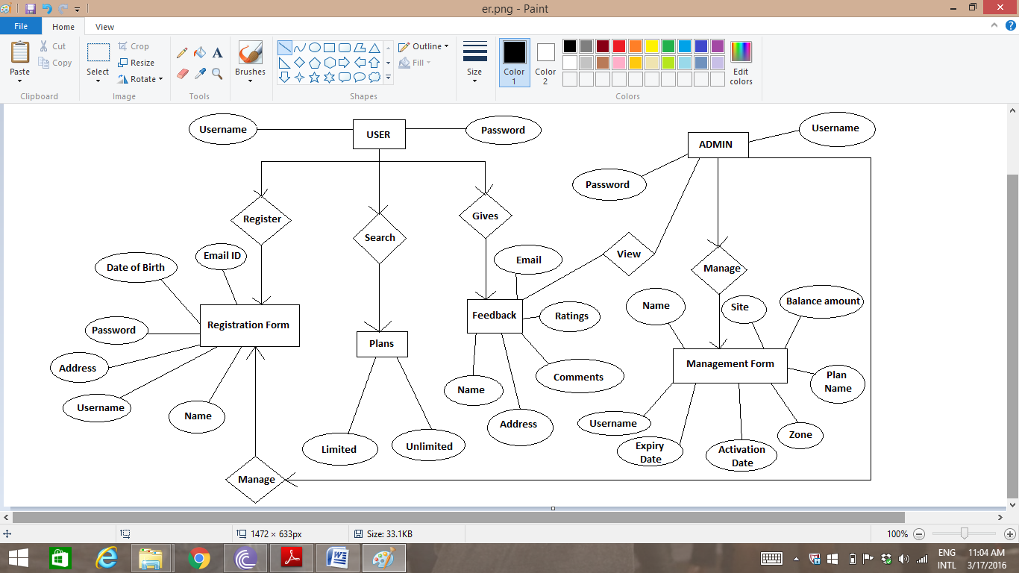
E-R DIAGRAM

Slide 12
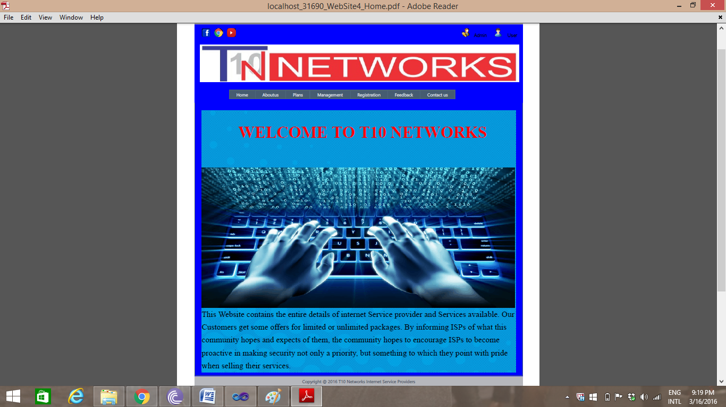
FORM LAYOUT

Slide 13
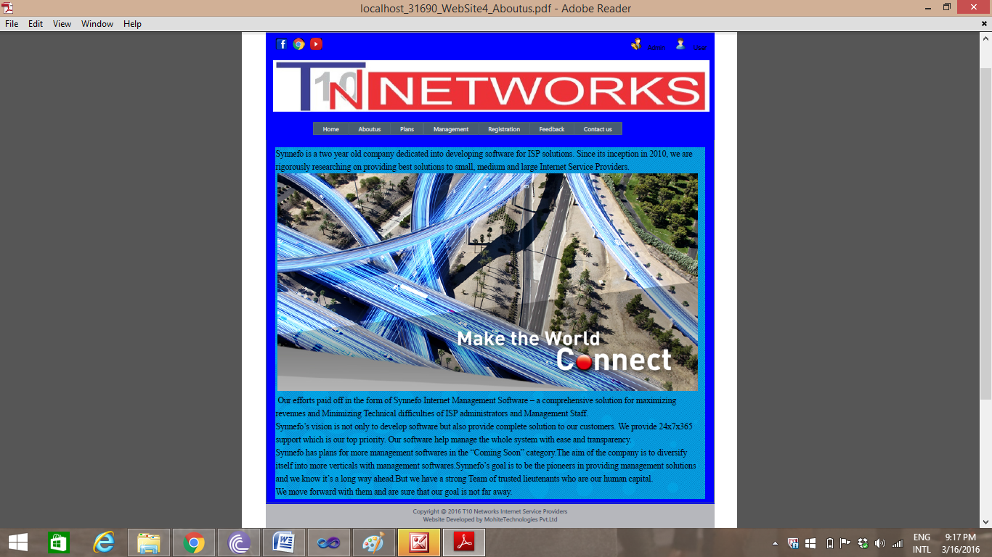

Slide 14
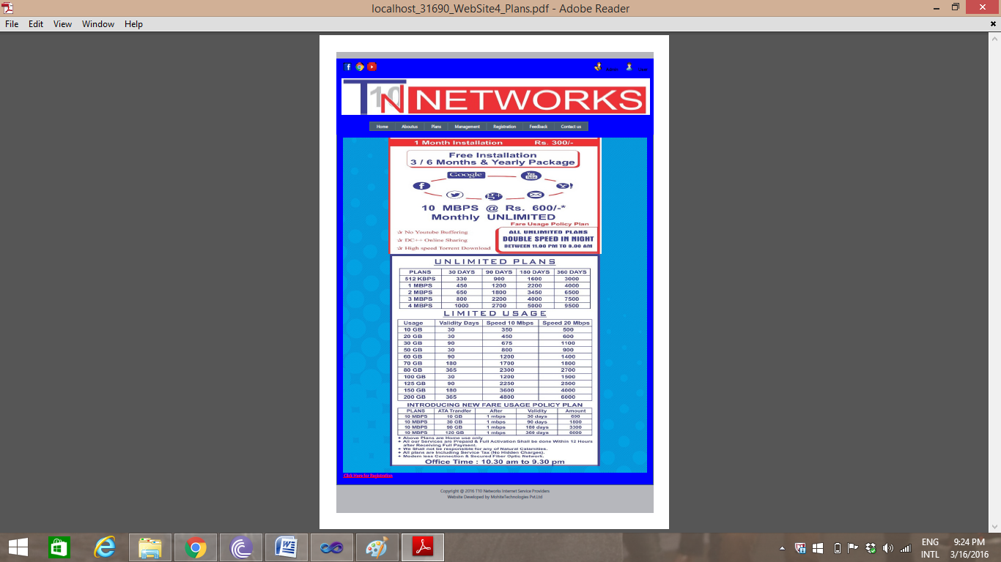

Slide 15
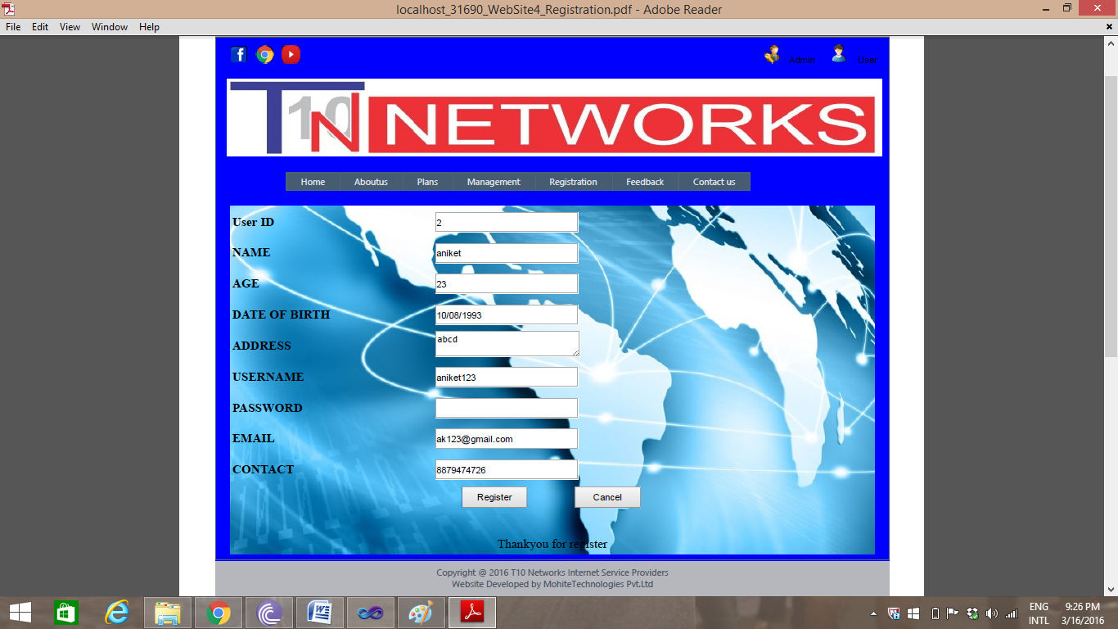

Slide 16
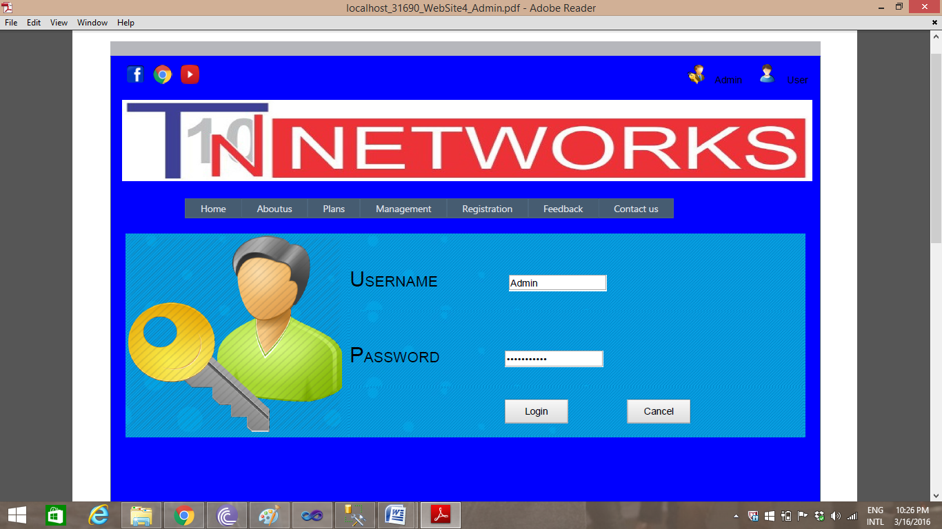

Slide 17
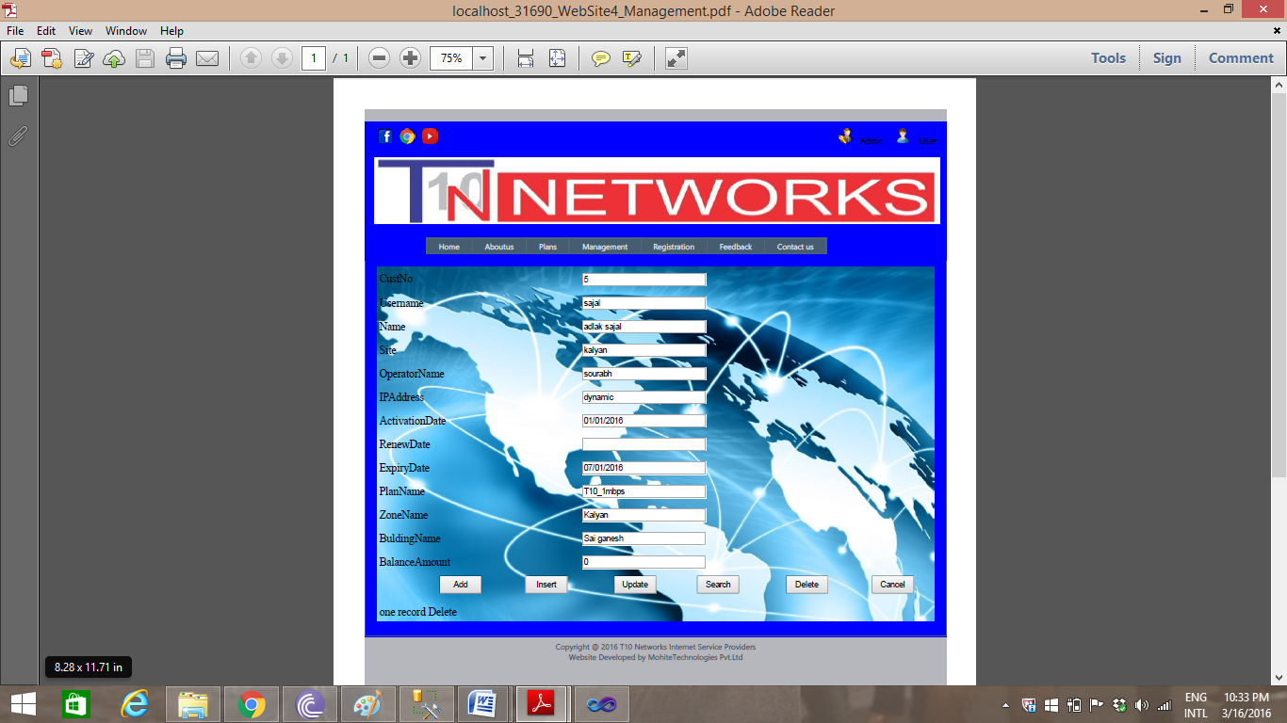

Slide 18
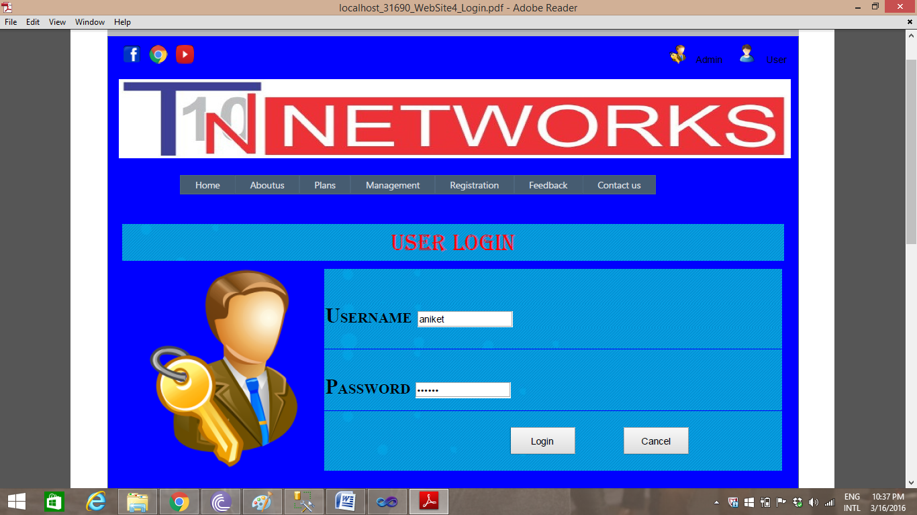

Slide 19
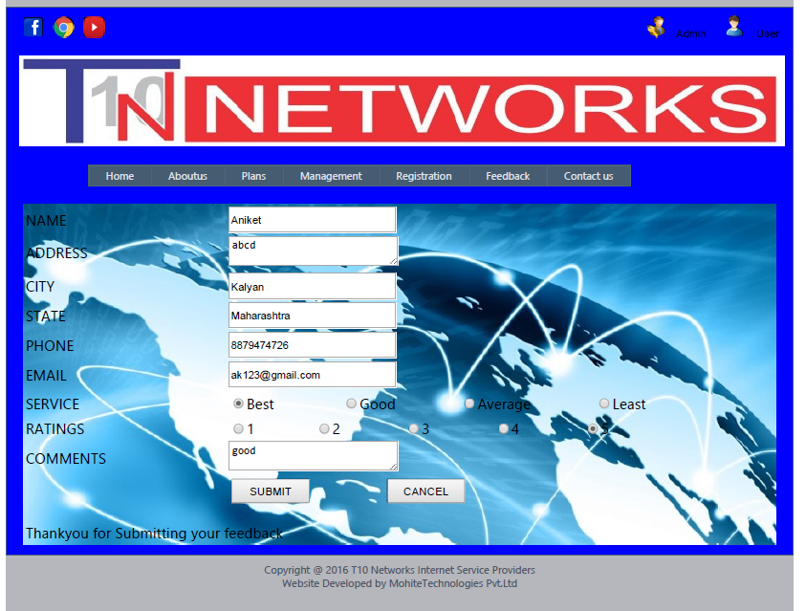

Slide 20
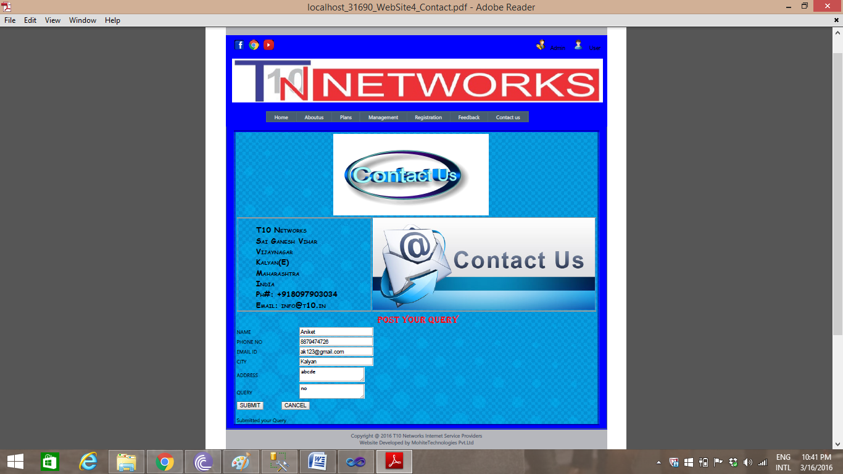

Slide 21
SUMMARY
There was good response of website.
Most of Internet Service Providers already use the Website for Management System.
Some respondents suggested there should be mobile web application for access the Internet Service Provider.
Some respondents suggested that provided SMS facility for report generation.

Slide 22
CONCLUSION
To conclude that the webpage is effective media to attract management system attention towards Internet Service Provider.
This website maintains the records of each and every Registration and Feedbacks, etc.
Hereby we conclude that this webpage can enrich the customer’s attention towards the Service.

Slide 23
BIBLOGRAPHY
ASP.NET Complete Reference
ASP.NET Programming [Black Book]
Laurence Moroney
Matthew MacDonald
The Complete Reference of SQL server 2008
James R. Groff & Paul N. Weinberg

Slide 24
WEBSITES REFERED
www.CodeGuru.com
www.w3Schools.com
www.synnefoims.com
www.jqueryscripts.in
www.dreamincode.net

Slide 25
THANK YOU

